Slide 1
Keynote Sponsor Address:
Cleaning Up a Beautiful Mess of BIM
Luke Johnson
On behalf of

Slide 2
BIM Can Be Messy but we CAN clean it up together!
Antiquated Engagement with the Project
Not Enough Time to Deliver Beautiful BIM?
Lack of Good Communication
Too Many Places to Look For Answers…

Slide 3
Part of the Answer
Project-Based Issue Tracking
An issue is any problem or question that may arise about a given topic… in our case, the federated, multi-discipline BIM dataset

Slide 4
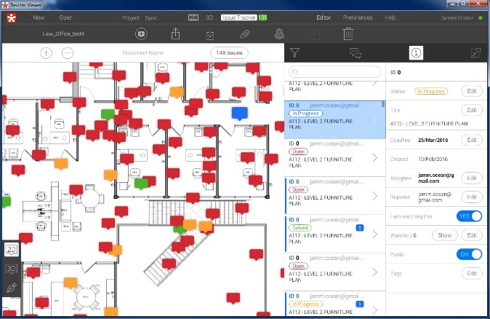
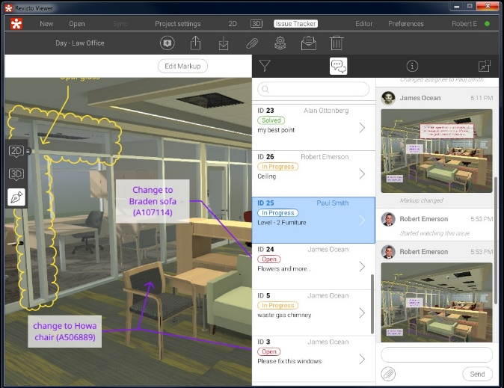

Slide 5
More of the Answer
Common Data Environment
Store and Combine:
2D information – drawings, photos, data sheets
3D models – multiple formats and plugins
Issue discussion, tracking and resolution

Slide 6
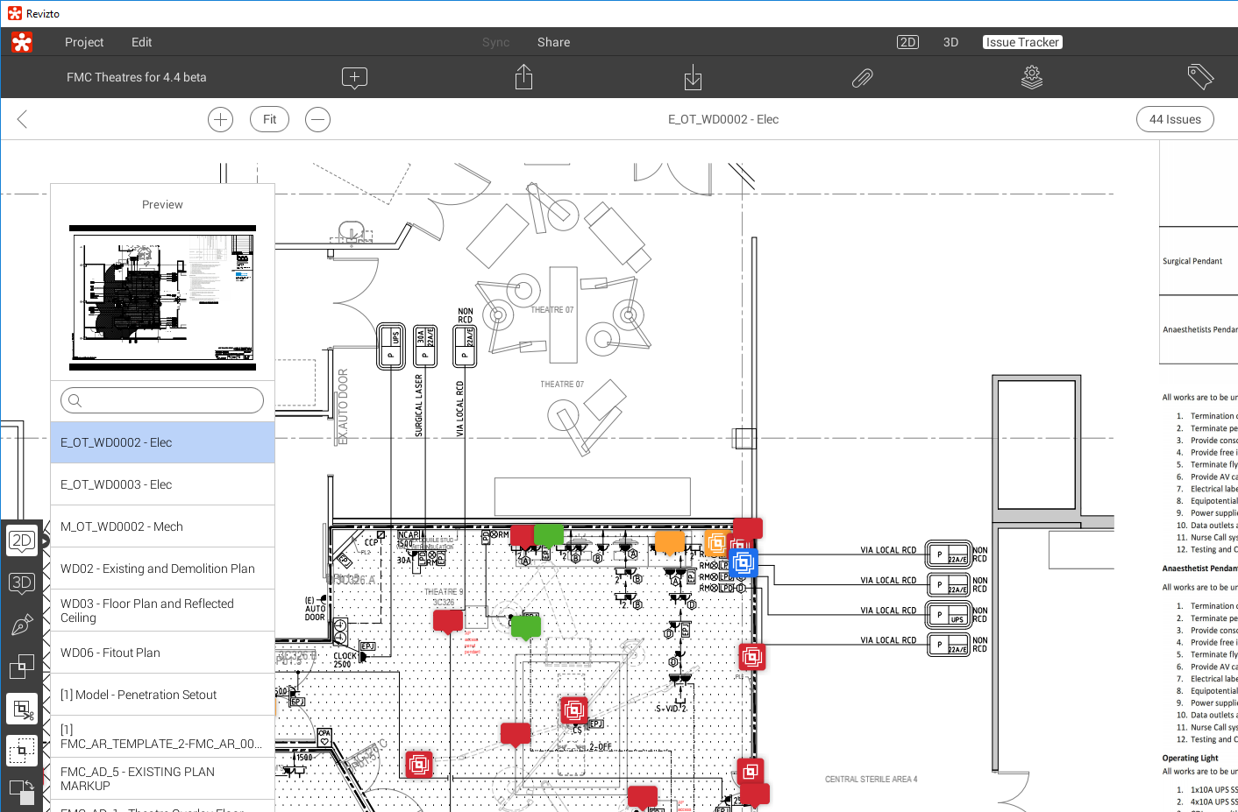
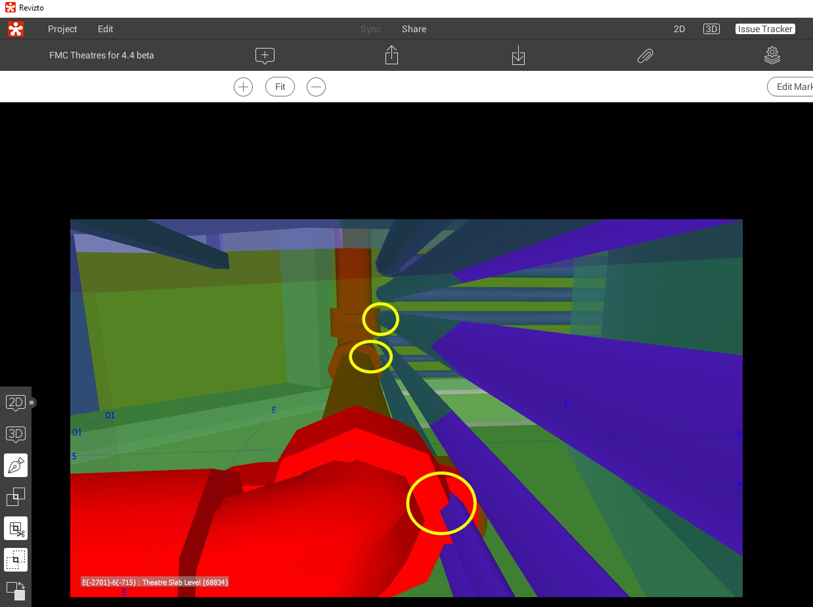

Slide 7
Many Applications
Design Presentation and Management
BIM Management and Coordination
Drawing and Document Review
Site Verification and Defects
Live Collaboration is an enabling tech.

Slide 8
Rapid Design and Construct Operating Rooms
Revizto Used For:
design & design coordination
builder engagement
subcontractor engagement
shop drawings
clash detection
coordination
construction
commissioning
Stored in Revizto:
Existing site photos
Existing as builts
Design drawings
Design discussions and deadlines
Subcontractor models
Clashes
Discussions about product selection

Slide 9
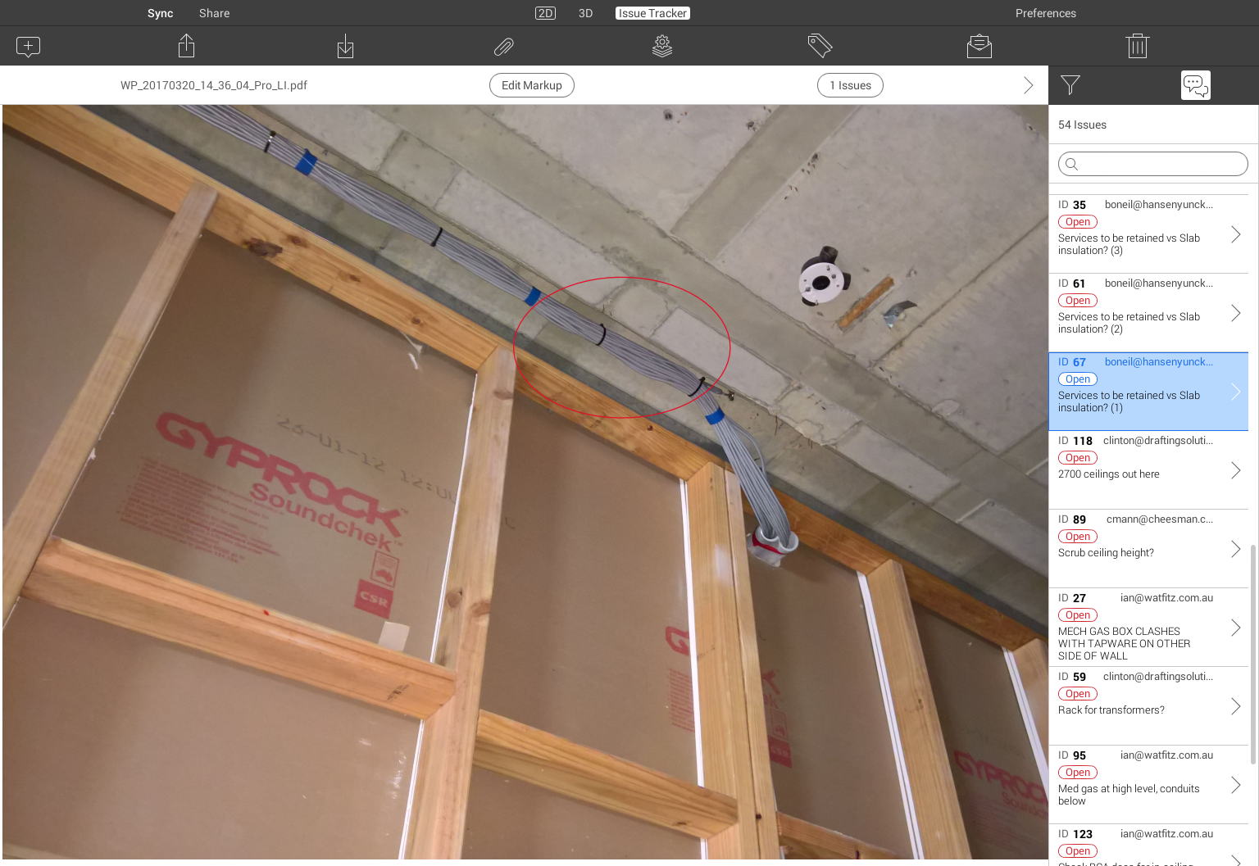
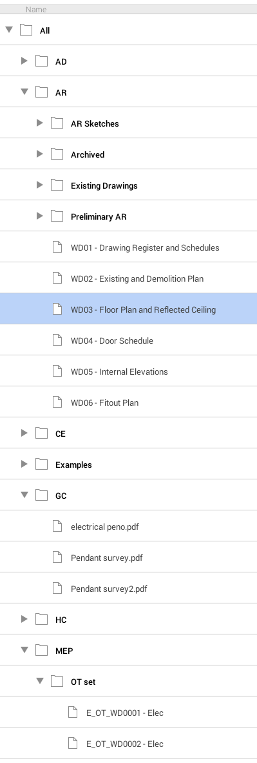
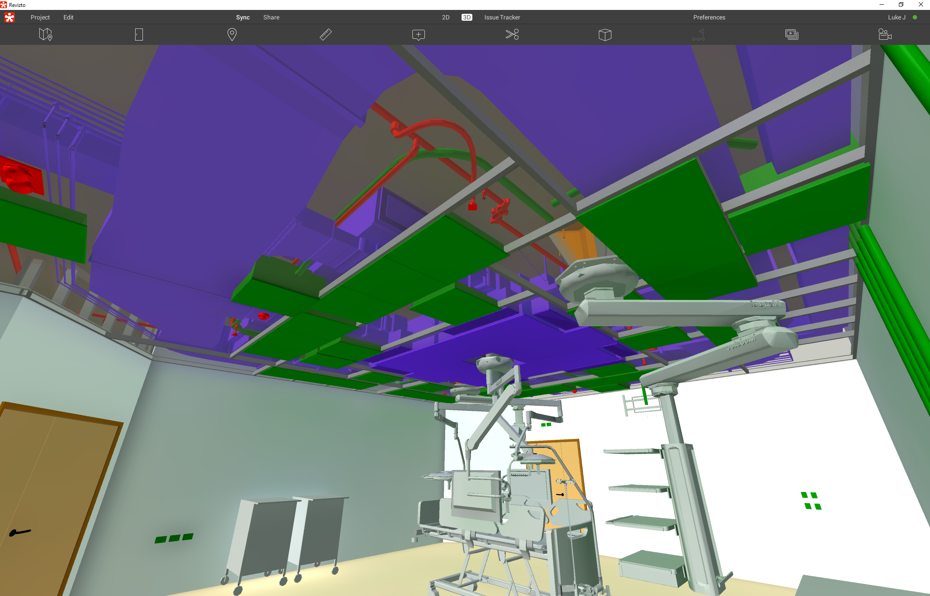

Slide 10
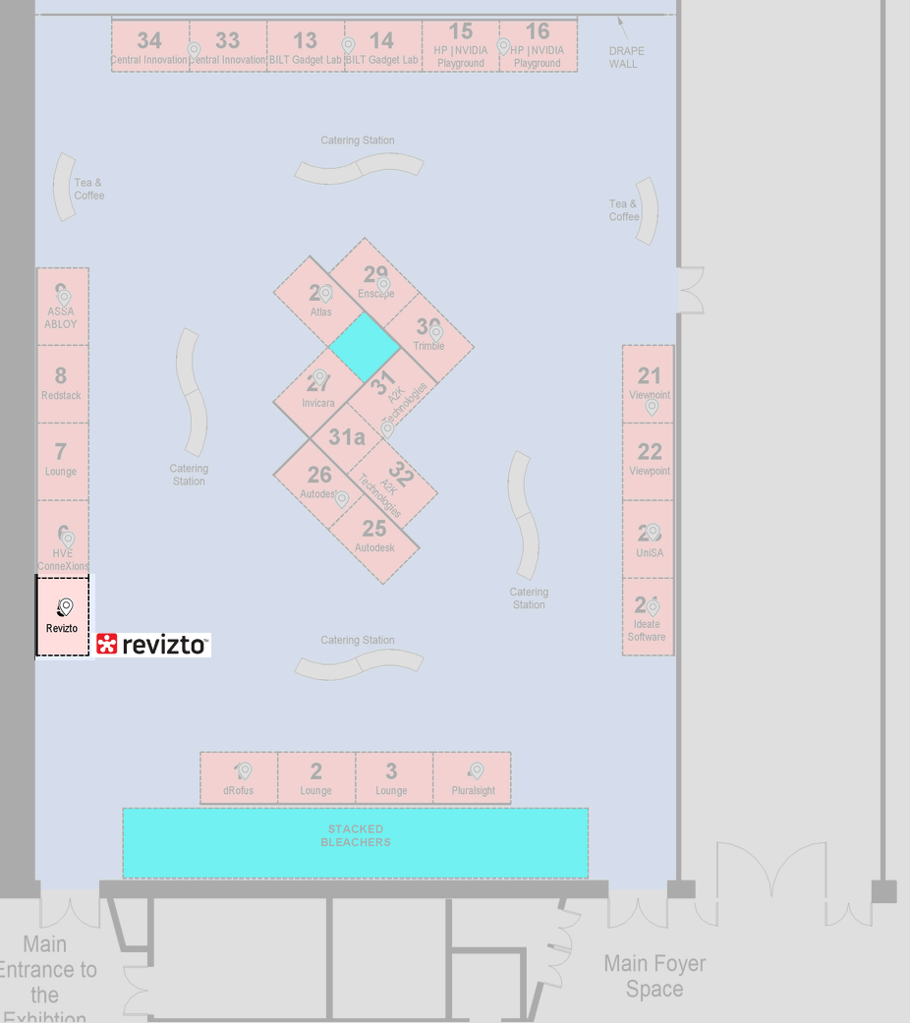
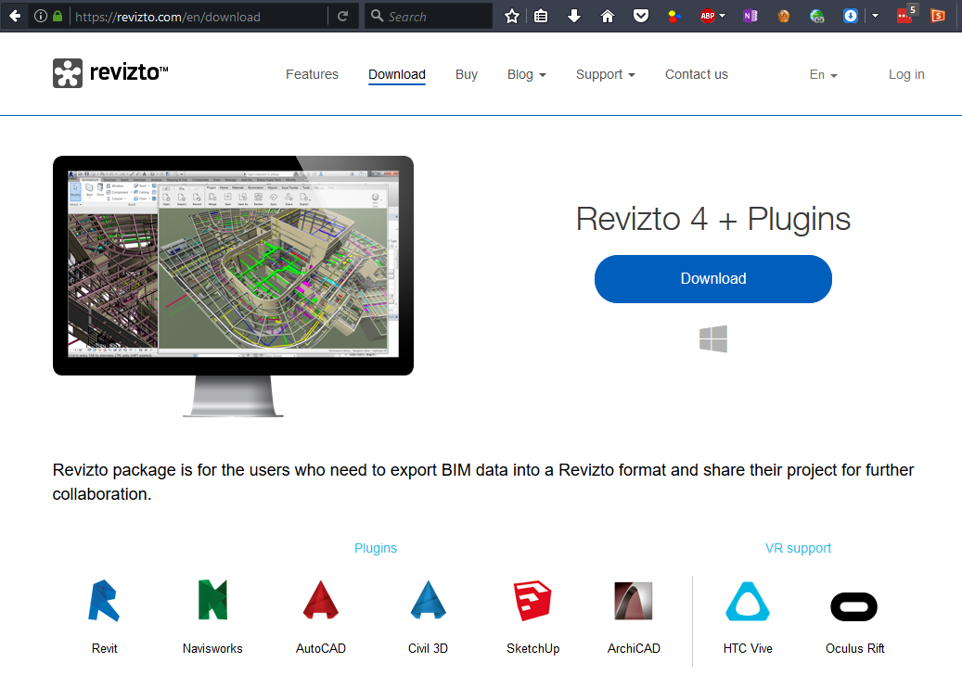
revizto.com

